Slide 1
Twice as nice?
A Longitudinal Field Study of Separate vs. Combined Nudges for Household Laundry Behaviours

Slide 2
Co-Authors & Partners
UBC
David Hardisty
Kirstin Appelt
Sid Mookerjee
Yanwen Wang
Jiaying Zhao
BC Hydro
Arien Korteland
Valerie Rodrigues
Netu Sidhu
Pre-registration: https://aspredicted.org/WWZ_WQ3

Slide 3
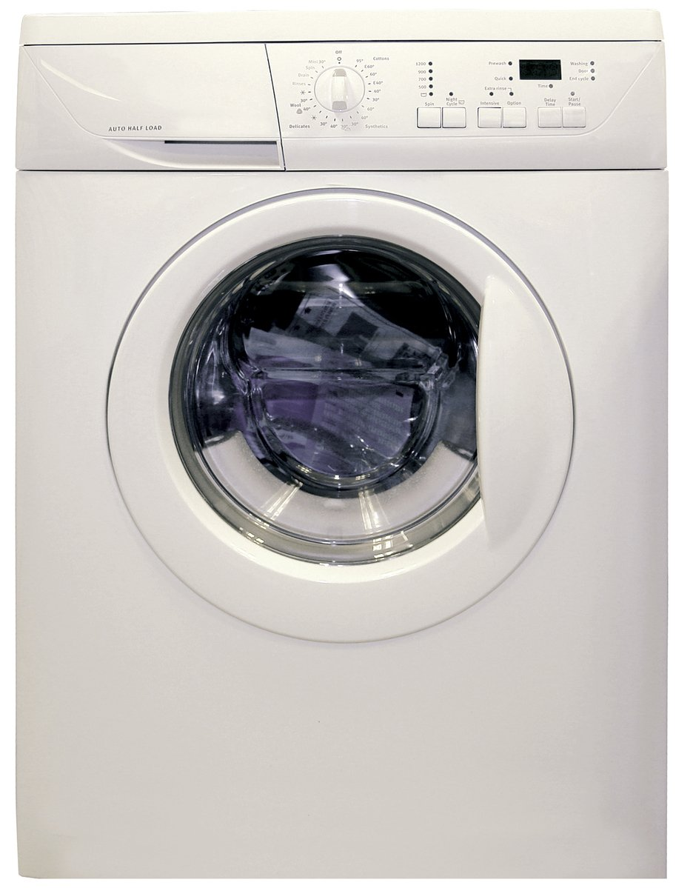
Practical Impact
Laundry represents about 19% - 28% of home energy use in houses using electric water heating (energy calculations based on data from https://www.energystar.gov/ )
Little research on changing laundry behaviour
Target behaviours:
Re-wear
Combine loads
Use cold water
Hang dry clothes
Image credit: https://en.wikipedia.org/wiki/Clothes_dryer#/media/File:Clothes_Dryer.jpg
Notes:
Image source: https://www.freeimages.com/photo/washing-machine-1418432

Slide 4
Study Design: Participants
N=1,210 BC Hydro customers recruited from BC Hydro’s Team Power Smart program and completed the first survey
Hourly energy meter data for 1 year study (plus 1 year prior history)
Follow-up surveys every 3 months, for 1 year total
Must have Washing Machine & Clothes Dryer and pay energy bill
64% women, mean age = 57
Research questions:
Long term impact of decal nudge?
Pro-environment message, pro-self, or both?
Request many behavior changes, or just one hard one?
Notes:
Note: 1,647 agreed to participate in advance, but only 1,158 completed the time 1 survey, mostly due to blocked emails from Microsoft-related email addresses (such as @hotmail, @outlook, @msn, and @live email addresses) blocking our emails.

Slide 5
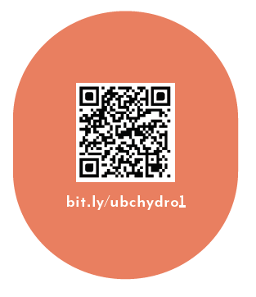
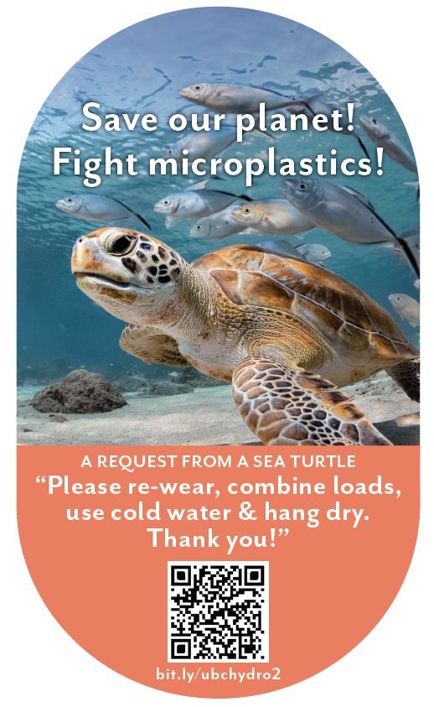
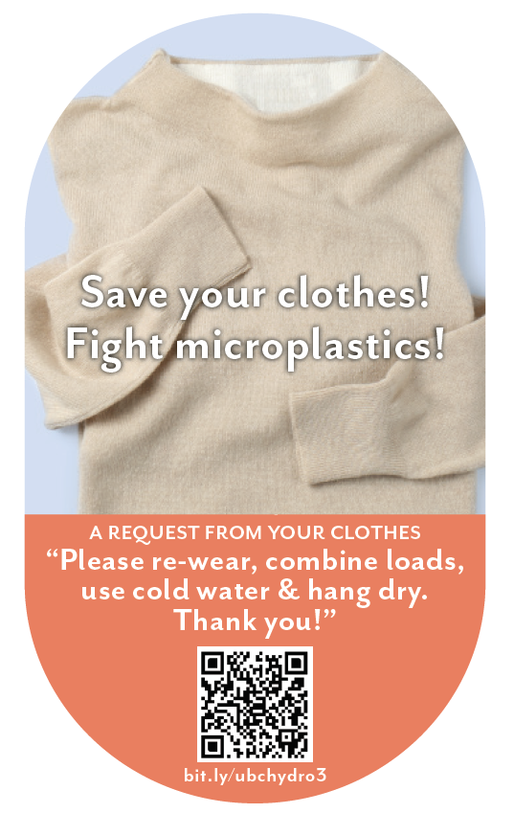
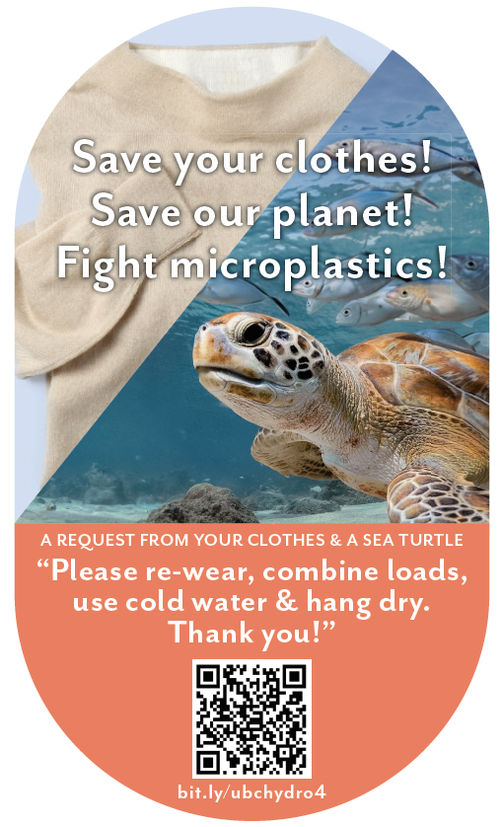
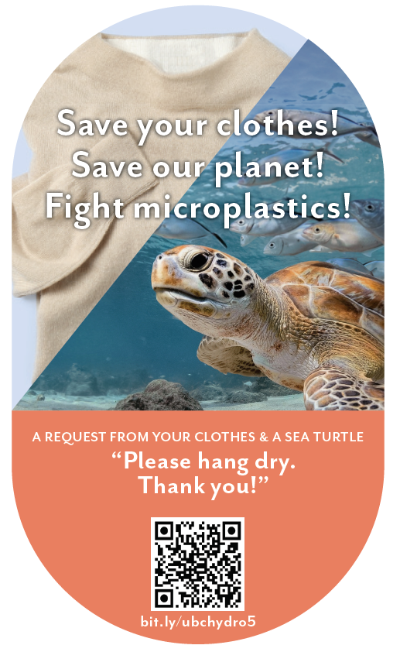
(1)
Study Design: Overview
Independent Variable: Participants randomly assigned to one of six conditions
(2)
(3)
(4)
(5)
(6)

Slide 6
Summary: Decal Effectiveness vs Control
Condition | Intentions | Self-report | Logged Washing | Logged Drying | Metered Washing | Metered Drying
Turtle + Bundle | ✓ | † | ✓ | ✓ | † | ✓
Fleece + Bundle | ✓
Turtle + Fleece + Bundle | ✓ |  |  |  | †
Turtle + Fleece + Hang Dry | ✓ | † |  | ✓ |  | ✓

Slide 7
Energy Meter Results: kWh for logging participants
Condition | n | Total Energy | Wash Energy | Dry Energy | Ratio (Dry/Wash)
Control (Decal only) | 94 | 15,168 | 139 | 121 | 0.81
Turtle + Bundle Msg | 91 | 14,704 | 105† | 79* | 0.68**
Fleece + Bundle Msg | 98 | 15,778 | 141 | 121 | 0.8
Turtle + Fleece + Bundle Msg | 72* | 14,240 | 102† | 82* | 0.79
Turtle + Fleece + Hang Dry Msg | 92 | 14,410 | 122 | 86* | 0.69**
Symbols indicate significant differences from control. † p < .1, * p < .05, ** p < .01
Notes:
In Canada, the overall electricity consumption in 2020 totals 13499.43 kWh

Slide 8
Conclusions
In the context of a motivated sample of BC laundry doers, over a period of one year:
Decals can be an effective nudging tool for sustaining energy efficient behaviour over time
Intentions often do not translate into real behaviour change
Most effective: combining a single, novel motivator (microplastics turtle) with multiple behaviour change requests

Slide 9
The Implemented Version

